Slide 1
DHESINGU RAJAN S
au412721205009
Car price prediction using regression in machine learning
3/21/2024 Annual Review

Slide 2
PROJECT TITLE Car Price Prediction using Regression in Machine Learning
3/21/2024 Annual Review

Slide 3


AGENDA
Introduction to the Project
Data Collection and Exploration:
Feature Selection and Engineering
Model Selection:
Deployment and Integration
Future Enhancements
3/21/2024 Annual Review

Slide 4

PROBLEM STATEMENT
To understand the factors affecting the pricing of cars in the American market, since those may be very different from the Japanese market. Essentially, the company wants to know:
Which variables are significant in predicting the price of a car
How well those variables describe the price of a car
Based on various market surveys, the consulting firm has gathered a large dataset of different types of cars across the American market.
3/21/2024 Annual Review

Slide 5

PROJECT OVERVIEW
The project aims to develop an car price prediction using Regression to accurately predict the cost of price.
This system will find applications in various domains including for predicting the price of used car price.
It aims to give the accurate results for users.
3/21/2024 Annual Review

Slide 6

WHO ARE THE END USERS?
Software Developers and Engineers
2. Researchers and Data Scientists
3. Social Investment banker ,Auditor , Market analyst , Finance analyst ...
4. Educators and Trainers
5. Marketing and Advertising Professionals
3/21/2024 Annual Review

Slide 7

YOUR SOLUTION AND ITS VALUE PROPOSITION
Gather a dataset containing relevant features such as make, model, year, mileage, fuel type, engine size.
Preprocess the data by handling missing values, outliers, and encoding categorical variables.
Perform exploratory data analysis to understand the distribution of features, relationships between variables, and identify patterns or trends.
Visualize data using histograms, scatter plots, correlation matrices, etc., to gain insights.
Engineer new features such as age of the car, average mileage per year, or categorical features encoding car brand reputation.
Transform numerical features (e.g., scaling) and handle categorical variables appropriately (e.g., one-hot encoding).
Perform hyperparameter tuning using techniques like grid search or random search to optimize model performance.
Validate the final model(s) using cross-validation to ensure robustness.
Deploy the trained model(s) as a web service or integrate it into an application for real-time predictions.
Implement monitoring and logging to track model performance and usage.

Slide 8

THE WOW IN YOUR SOLUTION
Interactive Visualization.
Augmented Reality (AR) Integration
Personalized Recommendations
Real-time Market Insights
Gamification Elements
Virtual Test Drives
Social Sharing Features
Voice and Natural Language Interaction
3/21/2024 Annual Review

Slide 9
MODELLING
Data processing
Splitting the Data
Choosing a Regression Model
Training the Model
Prediction
Model Evaluation
3/21/2024 Annual Review

Slide 10
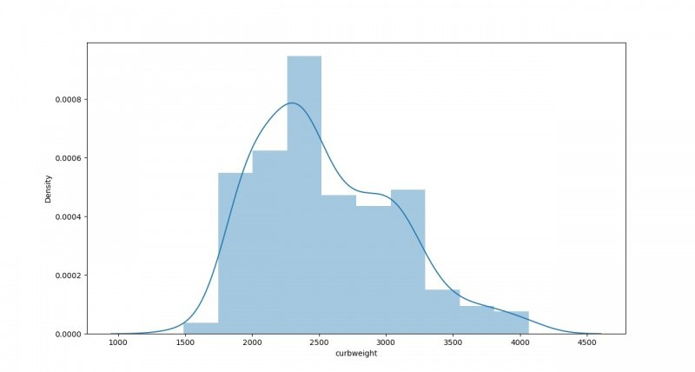
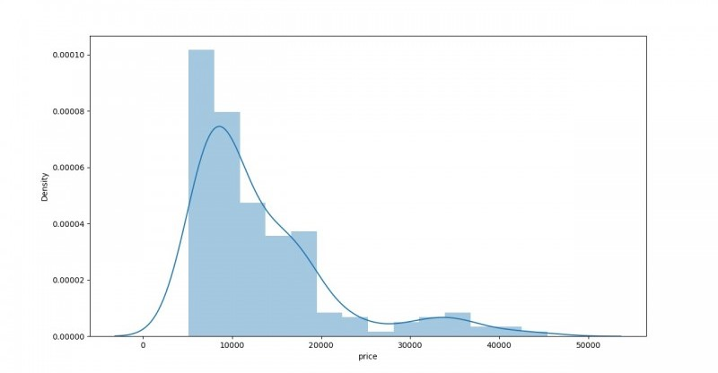
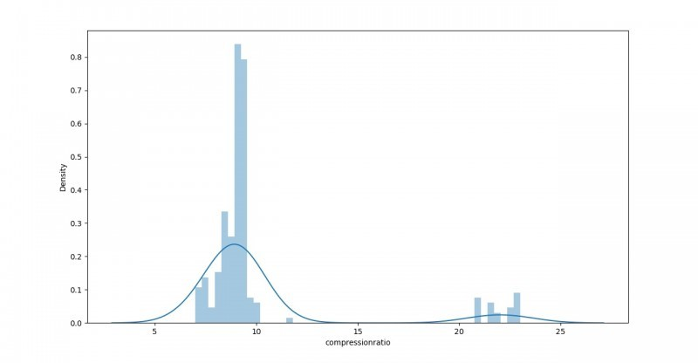
RESULTS

